Slide 1

Customer churn prediction
Saurabh Biswas
DSC-680
Bellevue University

Slide 2
Contents
Problem Statements
Proposal
Why Data Science
High Level Process Overview
Data
Data Cleaning & Exploratory Data Analysis
Model
Comparison
Test Results
Conclusion

Slide 3
Problem statements
Customer Churn directly hits business revenue
It is less expensive to retain a customer than attracting new ones
5% increase in customer retention will increase the profit by 25%
Returning customer will likely spend 67% more on company’s service

Slide 4
proposal
Machine Learning to perform Customer Churn Analysis
Identify group of customer at higher churn risk
Random Forest, Artificial Neural Network, Gradient Boosting & Naive Bayes
Training and Testing
Compare performance
Select the Best Model

Slide 5
Why data science ?
Manual Churn Analysis – time consuming and human dependent
Machine Learning techniques make it possible
Very little human intervention
Help in Identifying customers with higher risk of churn
Banks launch targeted promotion

Slide 6
Process overview
Gather Sample Data from Kaggle.
Perform Basic Analysis on the Data.
Carry Out Exploratory Data Analysis
Split into Train & Test.
Data Cleaning
Data Preparation

Slide 7
Process overview
Train Models.
Test & Compare Cross Matric.
Select Best Model.
Train on Entire Dataset.

Slide 8
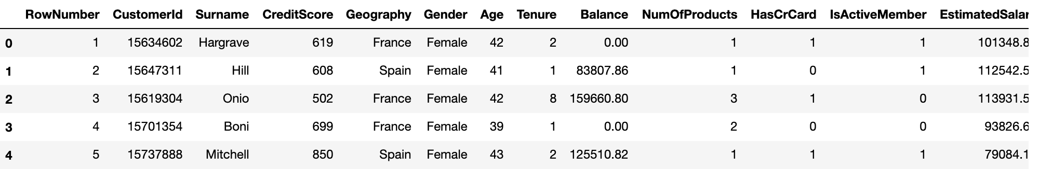
data
Scrapped banking customer account data from Kaggle
10000 Observations
13 features
10 important features
CreditScore
Geography
Gender
Age
Tenure
Balance
NumOfProducts
HasCrCard
IsActiveMember
EstimatedSalary

Slide 9
Data Cleaning & Exploratory Data Analysis
No Missing value
Dropped RowNumber, CustomerId & Surname
Converted Gender and Geography values
Gender: 1 –Male, 2-Female
Geography: 1 – France, 2 – Germany, 3 - Spain

Slide 10
Exploratory Data Analysis Questions
Relation between Age and Customer churn
Customer churn based on Geography
Customer churn based on gender
Customer churn based on number of products

Slide 11
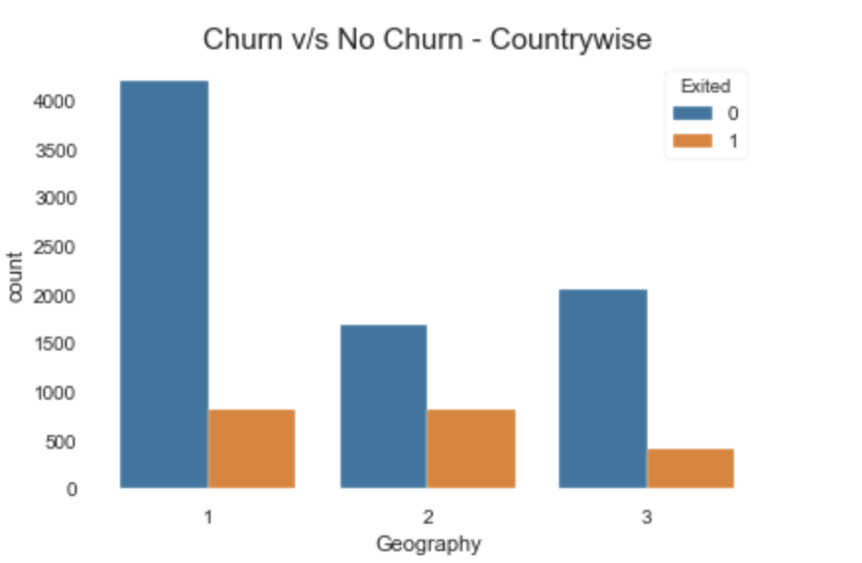
Churn – Geography wise

Slide 12
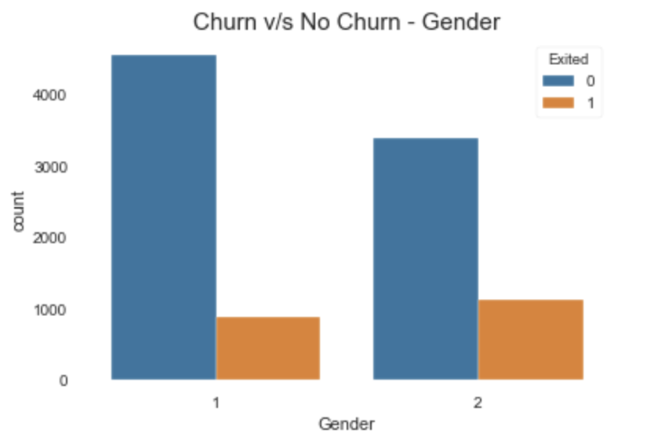
Churn by gender

Slide 13
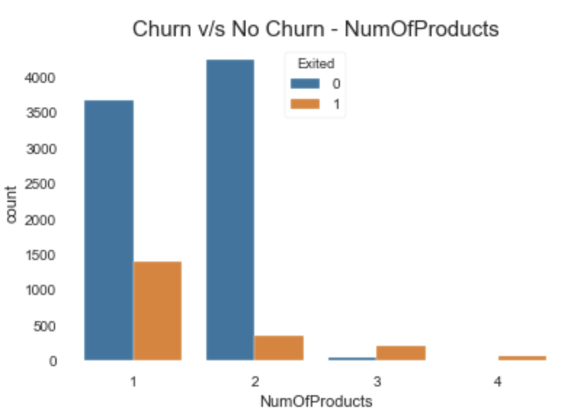
Churn – Number of products

Slide 14
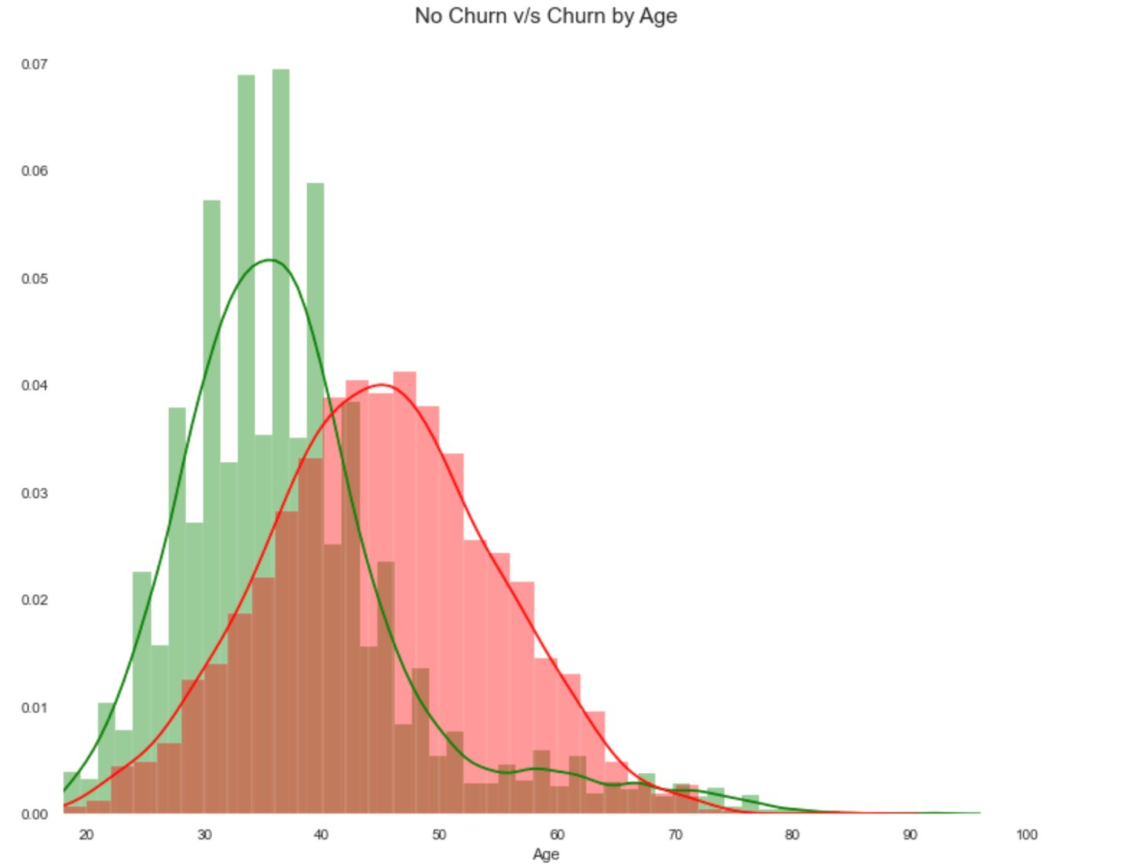
Churn by age

Slide 15
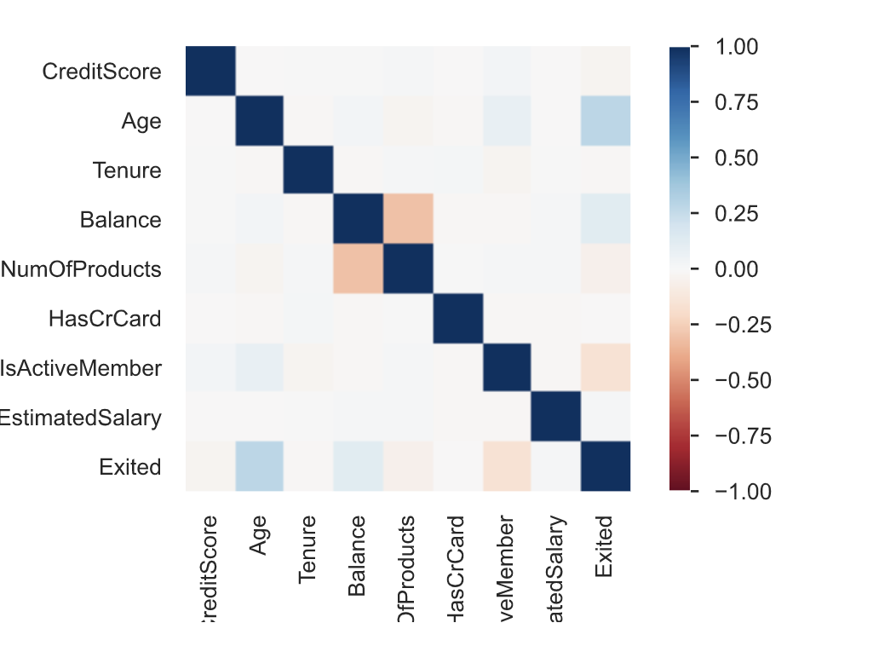
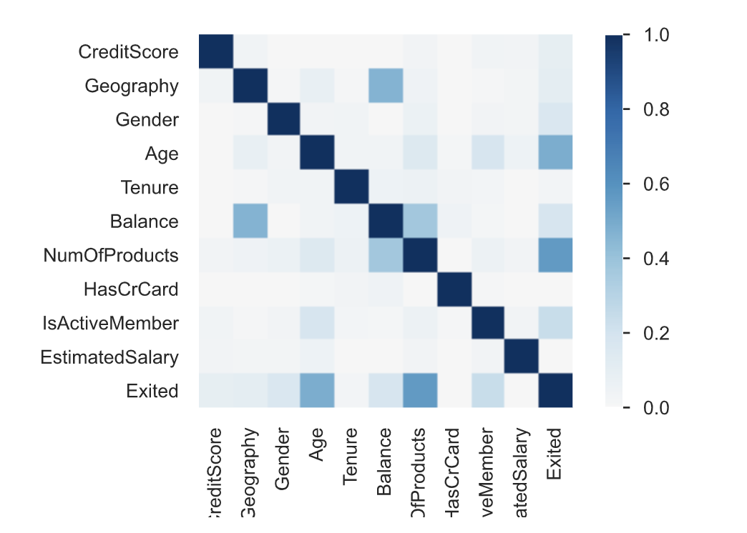
correlation

Slide 16
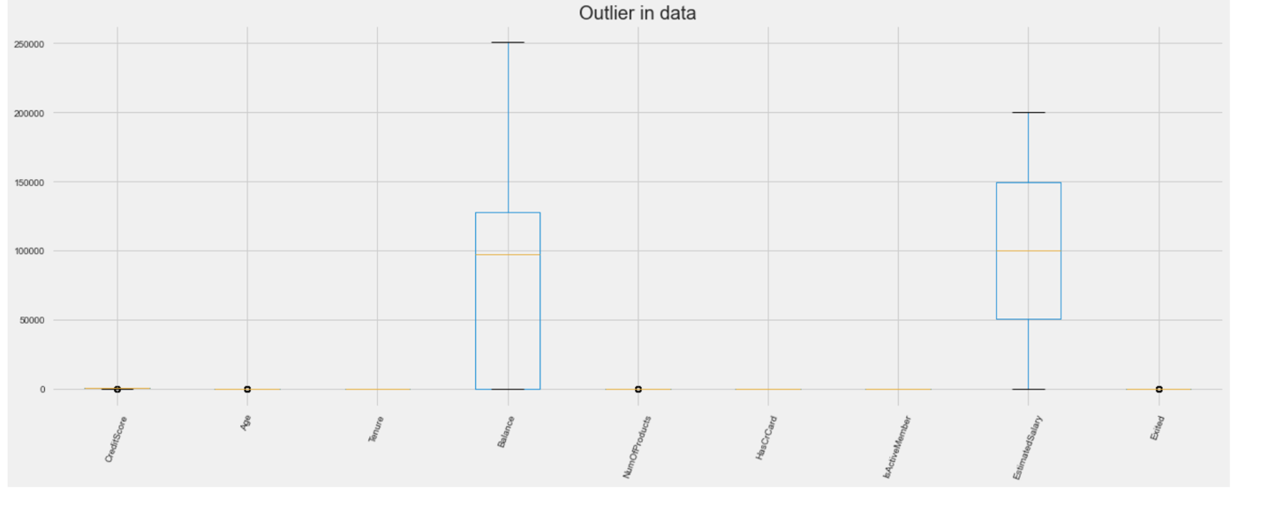
outliers

Slide 17
Data Preparation
Standardize using RobustScaler
Oversample using SMOTE

Slide 18
model
RF with Seed
RF Parameter – class_weight, max_depth, max_features, n_estimators & bootstrap
Artificial Neural Networkwith Seed
Naïve Bayes with Seed
Gradient Boosting

Slide 19
Model Comparison
Model | Best Paramter | Avg Precision Score
Naïve Bayes | var_smoothing: 1e-09 | 0.8229
ANN | max_iter: 300, solver: lbfgs | 0.9055
Gradient Boosting | learning_rate : 0.1, max_iter: 3000, max_leaf_nodes: 10, n_iter_no_change: 10, validation_fraction: 0.1 | 0.9643
RF | bootstrap: False, class_weight: balanced, max_depth: 30, max_features: sqrt, n_estimators: 200 | 0.9702

Slide 20
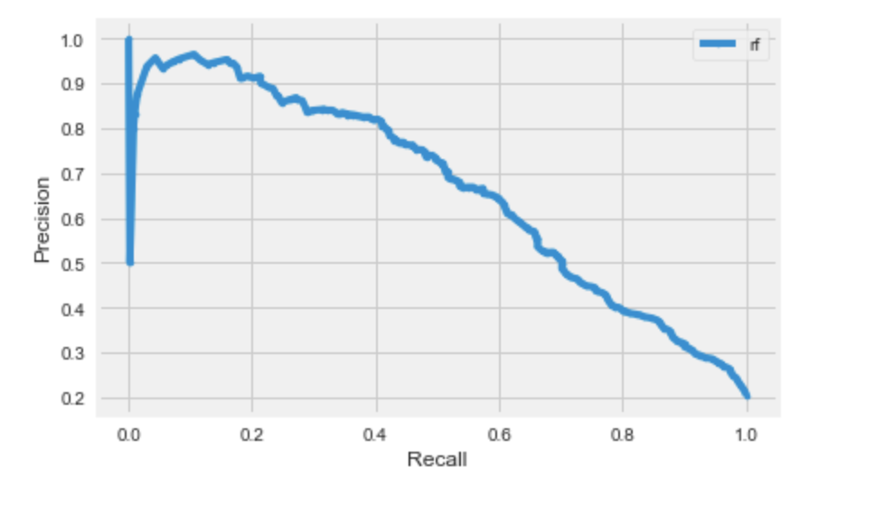
Test – Random Forest
Accuracy | 0.85
F1-Score | 0.62
Avg Precision Recall Score | 0.65
TP: 1827 | TN: 164
FP: 207 | FN:302

Slide 21
Conclusion
All the Models performed Pretty Well
Results from Test Dataset show that our decision to go with Random Forest is correct
Trained Random Forest model on Entire Dataset using best Parameter

Slide 22

Thank you

